Slide 2
Navigating the Ever-Changing Landscape of Shared Global Challenges
Guillaume Connan of Chabé
Vojkan Tasic of Limos4
Michael Oldenburg of United Limousine AG
Andrew Tighe of RMA Worldwide
Moderator: Nash Zakaria of Mimo Limousine
Audio Visual
Sponsor
Coffee Sponsor

Slide 3
Welcome & Thank You to Our Sponsors
Coffee Sponsor
Audio Visual Sponsor

Slide 4
Global Challenges:
Technology and Connectivity
Vojkan Tasic
Limos4
Audio Visual
Sponsor
Coffee Sponsor

Slide 5
Technology: A Big-Picture View
Evolving Industry
Technology is crucial to remain competitive
Multiple Layers
Fleet management, dispatch, booking, billing, CRM, communication, analytics, etc.
Interconnected Systems
Integration between internal operations and external travel platforms
Audio Visual
Sponsor

Slide 6
Technology: Breaking Down the Core Operational Layers
Fleet/Telematics
Ex: Samsara, Geotab, Verizon Connect
Purpose: Real-time tracking, maintenance alerts
Dispatch & Scheduling
Ex: Limo Anywhere, GroundWidgets, Livery Coach
Purpose: Efficient trip assignment, route optimization
Customer-Facing Booking & Reservations
Ex: Limo Anywhere, Book Rides Online, etc.
Purpose: Seamless customer scheduling, self-service booking, error avoidance
Payment & Billing
Ex: Stripe, Square, QuickBooks, Xero
Purpose: Automated invoicing, secure payment processing
CRM & Marketing
Ex: HubSpot, Salesforce, Zoho CRM
Purpose: Manage leads, automate marketing, nurture client relationships
Audio Visual
Sponsor

Slide 7
Connecting the Dots: Communication & Travel Industry Systems
Communication & Info Exchange
GNet, GroundSpan: Protocols that let different livery software systems share ride details
Why It Matters: Provides real-time data exchange between operators, ensures smooth handoffs
Travel Booker Tech Stack
OTAs (Expedia, Booking.com, Kayak): Customers/agents book travel online
GDSs (Amadeus, Sabre, Travelport): Core platforms used by airlines, hotels, travel agencies
OBTs (Concur, Egencia, Deem): Corporate travel management tools for large companies
Integration Flow (Simplified)
Travel Manager → OBT/GDS → GNET/GroundSpan → Your Dispatch System → Confirmed Ride
Audio Visual
Sponsor

Slide 8
Technology: Future Outlook & Q&A
Future Trends
AI & Machine Learning: Better route optimization, demand prediction, fully autonomous dispatch
EV Fleets & Green Branding: Meeting sustainability goals
Deep Integrations With Travel Tools: More seamless global coverage
Q&A?
Audio Visual
Sponsor

Slide 9
Global Challenges:
Impact of Sustainability
Guillaume Connan
Chabé
Audio Visual
Sponsor

Slide 10
Corporate Social Responsibility (CSR): Threat or Opportunity?
Feedback From a European Operator
Hired a full-time CSR manager in 2021
Defined a brand purpose and inserted it in our by-laws in 2022
Each year, scoring of our CSR performance by a third-party firm
Carbon emissions are monitored and offset each year: €50k spent in 2024 (for 2023 emissions)
60% of our fleet (400 vehicles) is either electric or hybrid
Member of the Global Compact (UN) since 2024
Audio Visual
Sponsor

Slide 11
CSR Investments/Expenses: Worth It?
Pros
Helps differentiate from competition
Many tenders include CSR criteria, sometimes at very high levels (>30%)
Helped us sign accounts in a few occasions (ex. Paris 2024 OG)
Direct fleet costs are ~30% lower for EVs (but indirect ones are higher/difficult to measure)
Helps recruit some talent, particularly among young ones
Cons
High proportion of international customers aren’t CSR sensitive
Significant and recurring costs (ca. 0,3 m€ per annum for us, excl. fleet)
Operating difficulties for EVs given time to charge and limited autonomy (ex. EQVs)
Audio Visual
Sponsor

Slide 12
CSR Investments/Expenses: Limits…
European CSR Directive to Be Implemented From 2026
If company meets criteria, necessity to collect data from 2025
Published together with financial report = extra financial reporting
Audited by a third-party, just like our accounts
On a consolidated basis = all subsidiaries
1,000+ potential datapoints of which > 400 we will need to collect from year 1
Ca. 1 additional FTE dedicated to this + third-party advisors and auditors = 0,2 m€ additional expenses… nonsense!
Audio Visual
Sponsor

Slide 13
Global Challenges:
Insurance and Liability
Michael Oldenburg
United Limousine AG
Audio Visual
Sponsor

Slide 14
Risk Management Strategy When Outsourcing to Affiliates
Due Diligence and Selection of Partner Companies
Vetting Process: Check licenses, insurance, safety records, and customer reviews
Contractual Agreements: Establish clear agreements on responsibilities, liabilities, and SLAs
Regular Audits: Ensure compliance with safety standards
Insurance and Liability
Adequate Coverage: Ensure both companies have sufficient insurance coverage
Liability Agreements: Clearly define liability in contract
Audio Visual
Sponsor

Slide 15
Insurance: Safety, Data Privacy, and Customer Service
Safety Standards and Driver Qualifications
Driver Screening: Conduct background checks and drug testing
Safety Training: Ensure drivers are trained in safety standards
Vehicle Maintenance: Verify that vehicles are maintained in safe operating condition
Data Security and Customer Service
Data Protection Agreements: Safeguard customer data and comply with regulations
Customer Feedback: Collect feedback on service quality
Audio Visual
Sponsor

Slide 16
Passenger Insurance in Dedicated Countries
Recommendations
Insurance requirements and coverage can vary significantly by country and service provider
Insurance terms and coverage limits can change, and it’s essential to verify the current details with the service provider
Consider your company’s insurance needs before farming out services: Verify that vehicles are maintained in safe operating condition
Always confirm the insurance coverage details with the affiliate
Ensure that the policy includes sufficient personal injury protection for all passengers
Audio Visual
Sponsor

Slide 17
Insurance Coverage of Dedicated Countries
Country | Minimum Coverage for Personal Injuries | Details
United States | Varies by State | Insurance requirements for chauffeur-driven services vary by state. Some states have specific mandates for limousine services, while others may not.
France | Unlimited for Bodily Injury | French law mandates unlimited coverage for bodily injury under vehicle liability insurance. This means that in the event of an accident, there is no cap on the compensation available for personal injuries to passengers. (Wikipedia)
Germany | Approximately $8,000,000 | The statutory minimum coverage for personal injuries is around €7.5 million, which equates to approximately $8 million USD. This high coverage ensures substantial protection for passengers in chauffeur-driven services.
Japan | Unlimited Per Person | Chauffeur-driven services typically include insurance that offers unlimited coverage per person for bodily injury or death.
Mexico | Approximately §3,800 | The basic personal liability insurance included with chauffeur-driven services usually covers up to 50,000 Mexican Pesos, which is around $3,800 USD only.
South Africa | Not Mandatory | Passenger liability insurance is not legally required for chauffeur-driven services, but it is highly recommended.
Audio Visual
Sponsor

Slide 18
Global Challenges:
Service Standards
Andrew Tighe
RMA Worldwide
Audio Visual
Sponsor

Slide 19
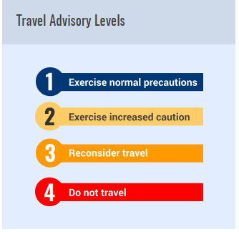
Service Standards: Client Expectations
Consistent, Reliable, and Safe Services (U.S. State Dept. Travel Advisories)
An easy-accurate booking process and a knowledgeable staff
Chauffeur and Vehicle Standards
- Understanding the variation across markets
For Every Service There Are Two Clients: Passenger and Booker
- Knowing the expectations of each is crucial
VIP Passengers and the C-Suite
- How do you elevate your standard service?
Incident Resolution: What Sets You Apart When an Incident Occurs?
- Lose the battle, win the war mentality
Audio Visual
Sponsor

Slide 20
Service Standards: Affiliate Expectations
Accurate Quoting and Billing of Services
- Ensure currency of quotation and payment are clear to all parties
Ability to Replicate the Same Level of Service Globally as You Provide Locally
Back-office API System Connectivity: Status Updates and GPS Tracking
Shared Vision – Attentive – Caring – Aligned Goals
Incident Resolution
Insurance Requirements – Minimize Your Risk and Exposure

Slide 21
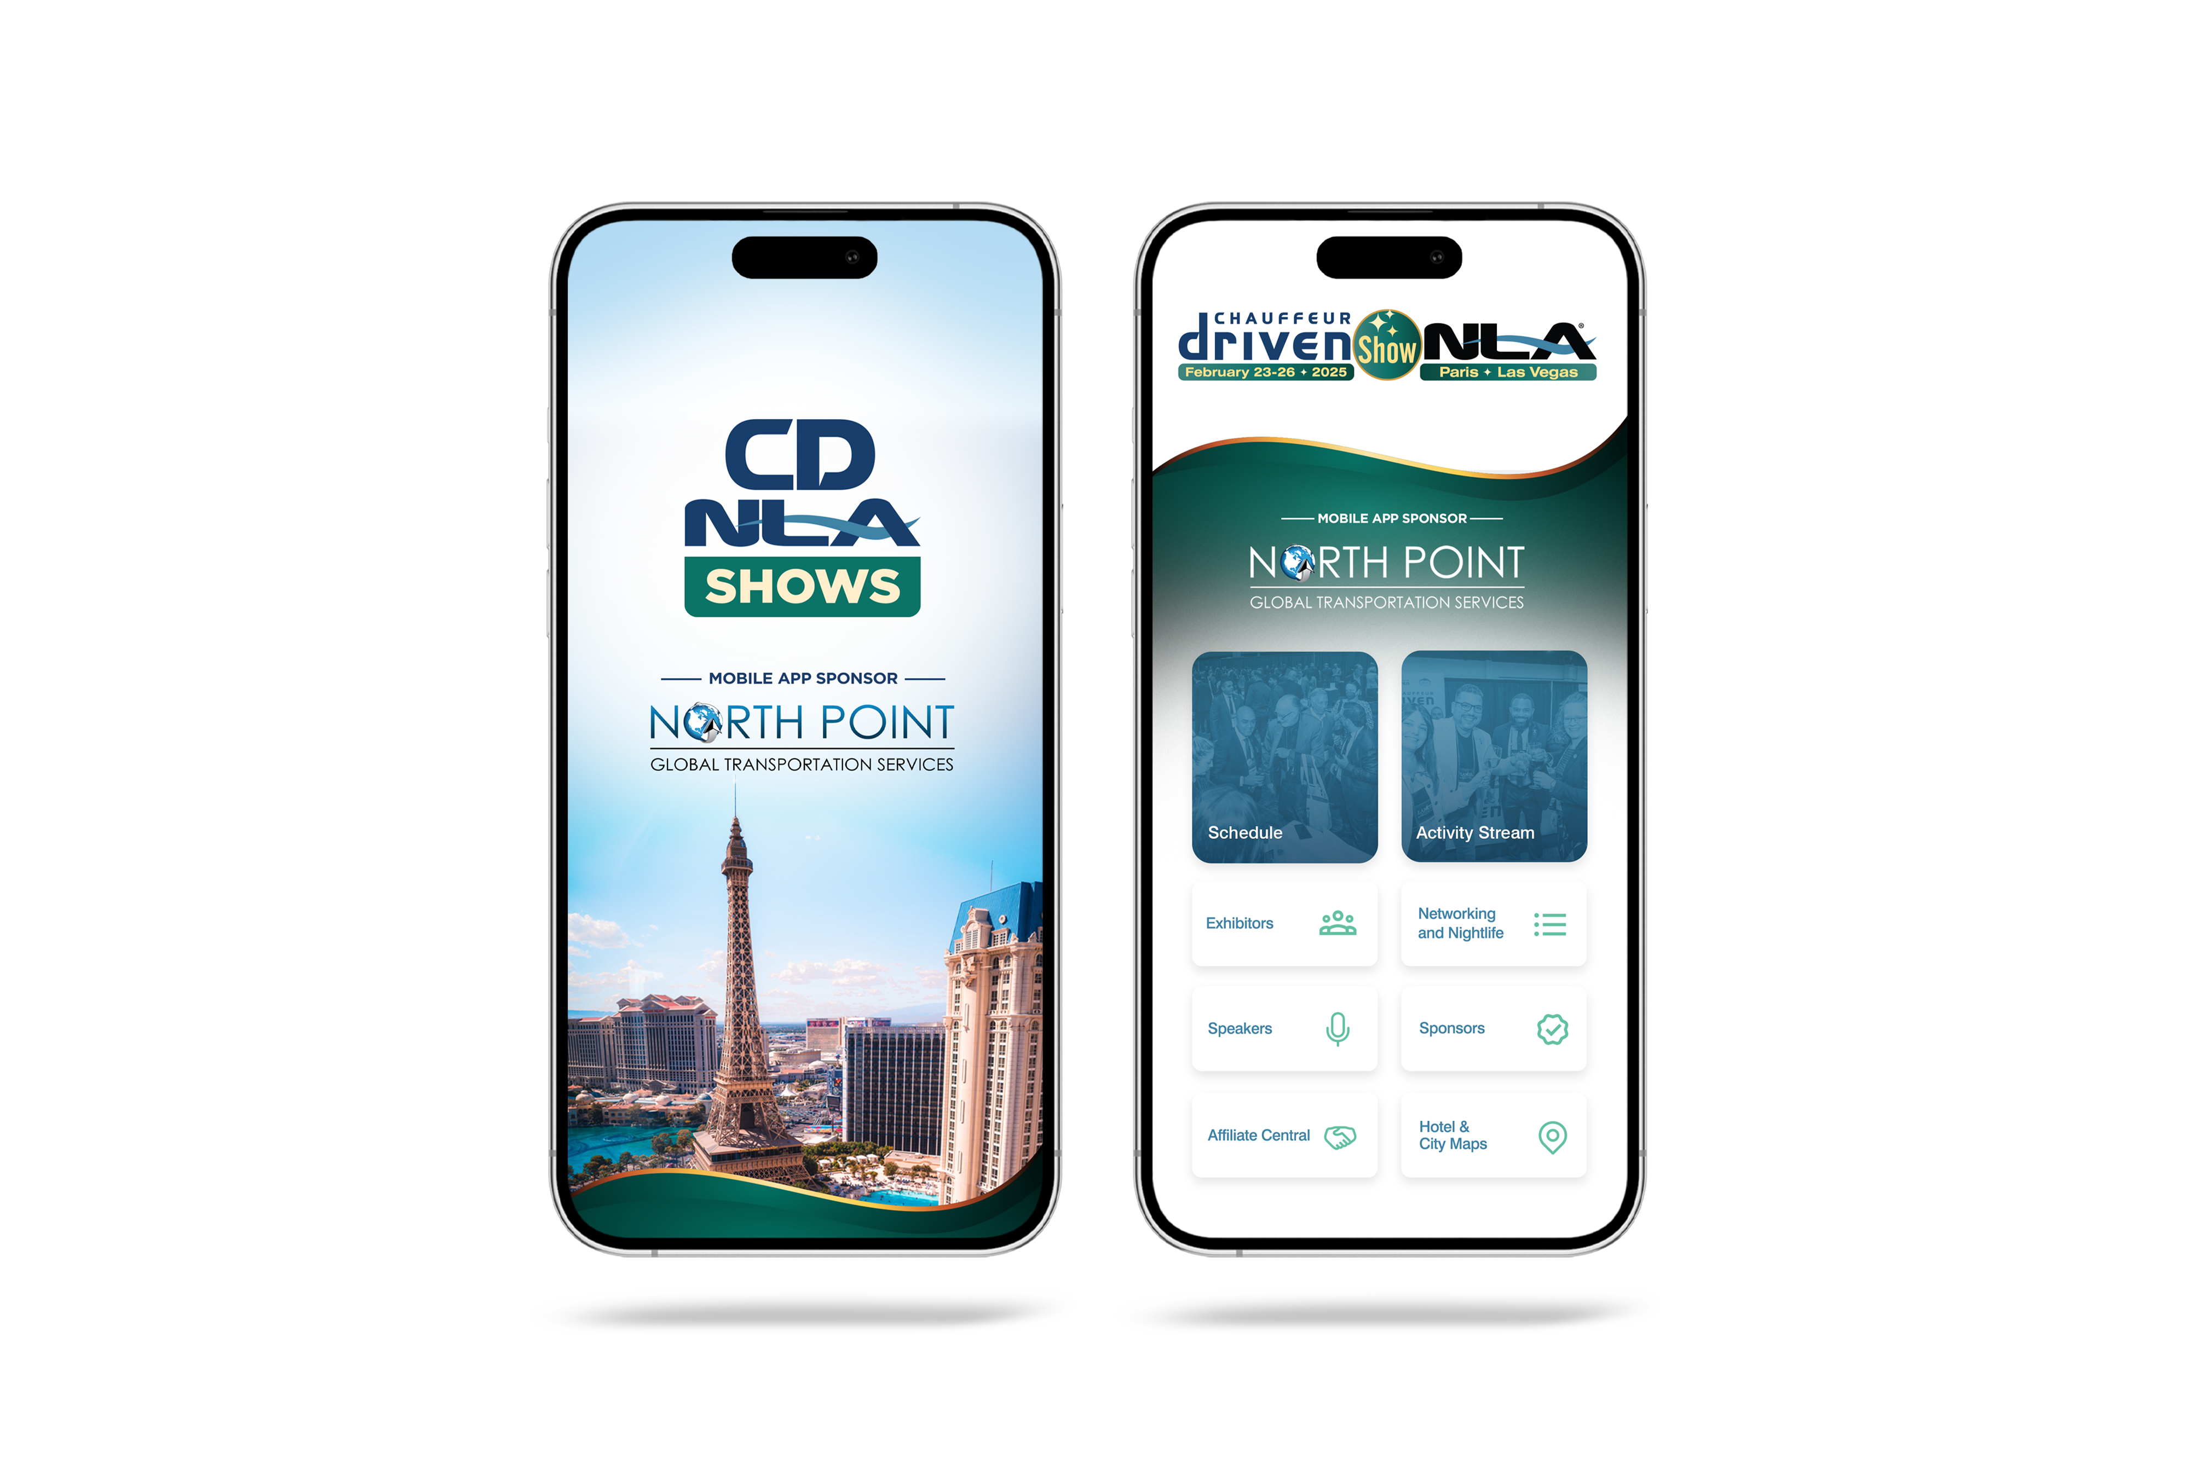
Let Us Know How
We Did!
Fill Out the Survey

Slide 22
Thank You for Joining Us!

